Slide 1

FY25 Budget Approval Meeting

Slide 2
Norms
This is a meeting of the GO Team. Only members of the team may participate in the discussion. Any members of the public present are here to quietly observe.
We will follow the agenda as noticed to the public and stay on task.
We invite and welcome contributions of every member and listen to each other.
We will respect all ideas and assume good intentions.

Slide 3
Agenda
Action Items
Approval of Agenda
  Approval of Previous Minutes
  Budget Approval (after final presentation/review and discussion)
Discussion Items
Presentation of the final budget
  Security Grant Survey
Information Items
Principal’s Report
Announcements
  Complete EOY GO Team Surveys

Slide 4


Overview of FY ‘25 GO Team Budget Process
Step 1 Review and Update Strategic Plan and Rank Strategic Priorities
By end of Fall Semester
Step 6 Principals: HR Staffing Conferences Begin
Late February – Early March
Step 3 GO Team Initial Budget Session: Allocation
January 17– early February
Step 7 GO Team Final Budget Approval Meeting
Budgets Approved by March 15
Step 5
GO Team Feedback Session: Draft Budget Presented & Discussed
February – multiple meetings, if necessary
Step 4 Principals: Associate Supt. Discussions and Review
February (supports needed, specific challenges, coaching)
Step 2 Principals: Workshop FY 25 Budget
January 17, 2024
GO Teams are encouraged to have ongoing conversations throughout the year about the school’s budget.

Slide 5
Budget Approval Meeting
What
During this meeting GO Teams will review the budget, which should be updated based on feedback from the staffing conference, Associate Superintendents, and key leaders. After review, GO Teams will need to take action (i.e., vote) on the FY25 Budget.
Why
Principals will present the final budget recommendations for GO Team approval.
When
All approval meetings must be held after staffing conferences. Budgets must be approved by March 15th.

Slide 6
Budget Review

Slide 7

FY24 Budget Parameters
FY24 School Priorities | Rationale
Improve percent of students achieving at proficient level on Milestones assessment | Provide instruction to prepare students for their next educational level and remove instructional gaps caused by Covid
Implement International Baccalaureate program model | Provide rigor and ensure our students think globally
Ensure a welcoming parent friendly environment | increase parent involvement to strengthen the partnership between school and home
Notes:
Review the priorities that the GO Team has developed and the rationale for these priorities. Feel free to copy this slide if you have more than 3 priorities to account for.

Slide 8
FY24 Budget Parameters
FY24 School Priorities | Rationale
Maximize the intervention block daily | Dedicated time for students to receive specific interventions and/or enrichment.
Notes:
Review the priorities that the GO Team has developed and the rationale for these priorities.

Slide 9
Descriptions of Strategic Plan
Breakout Categories
Priorities: FY25 funding priorities from the school’s strategic plan, ranked by the order of importance.
APS Five Focus Area: What part of the APS Five is the priority aligned to?
Strategies: Lays out specific objectives for school’s improvement.
Request: “The Ask” What needs to be funded in order to support the strategy?
Amount: What is the cost associated with the Request?

Slide 10
FY25 Strategic Plan Break-out
Priorities | APS FIVE Focus Area | Strategies | Requests | Amount
Increase proficiency on Milestones and remediated skills | Curriculum and instruction Data | Create full time Response to intervention teacher for student support and progress monitoring | Purchase fulltime SST Teacher | 109,000
Implement International Baccalaureate program | Signature Programs Data | Conduct professional development of teachers and meet program requirements | Hire Full Time IB Coordinator | 109,00
Increase Family Engagement | Whole child | Conduct parent training sessions and improve communication of events and how to assist students | Hire Full Time Parent Liaison | 49,000
Decrease the number of students with ten or more days absent and support families | Whole child | Create attendance and Care Teams to support parents and remove barriers for attendance | Hire a full time Social Worker and Nurse | 150000
Notes:
For the next few slides, I will show you how I have allocated the budget to support our strategic priorities.
Based on our strategic priorities and funds we received, here is a break-out of the priorities, which focus area it addresses, the strategies that will be implemented, the purchase request, which funding source was used and the amount.

Slide 11
Plan for FY25 Title I Family Engagement Funds
$6672
Priorities | APS Five Focus Area | Strategies | Requests | Amount
Increase parental engagement and student attendance | Whole child | Provide incentives for attendance and participation in school activities | Purchase incentives for students meeting attendance targets | $6672
Notes:
For the next few slides, I will show you how I have allocated the budget to support our strategic priorities.
Based on our strategic priorities and funds we received, here is a break-out of the priorities, which focus area it addresses, the strategies that will be implemented, the purchase request, which funding source was used and the amount.

Slide 12

Staffing Conference Changes
There were not any changes made to the draft budget we discussed at our last meeting.

Slide 13
FY25 Budget by Function (Required)
*Based on Current Allocation of School Budget
School | West Manor Elementary School
Location | 2569
Level | ES
Principal | Reginald Lawrence
Projected Enrollment | 244
Account | Account Description | FTE | Budget | Per Pupil
1000 | Instruction | 28.05 | $2,922,533 | $11,978
2100 | Pupil Services | 4.25 | $400,672 | $1,642
2210 | Improvement of Instructional Services | 2.00 | $256,066 | $1,049
2213 | Instructional Staff Training | - | $- | $-
2220 | Educational Media Services | 1.00 | $123,029 | $504
2400 | School Administration | 3.00 | $417,913 | $1,713
2600 | Maintenance & Operations | 2.50 | $152,083 | $623
2700 | Transportation | - | $- | $-
Total |  | 40.80 | $4,272,297 | $17,509
Notes:
I am passing out the definitions for these funding categories. You will see what makes up each category. Although the school’s total budget amount will not change, allocation per function may change depending on our conversations and school needs.

Slide 14
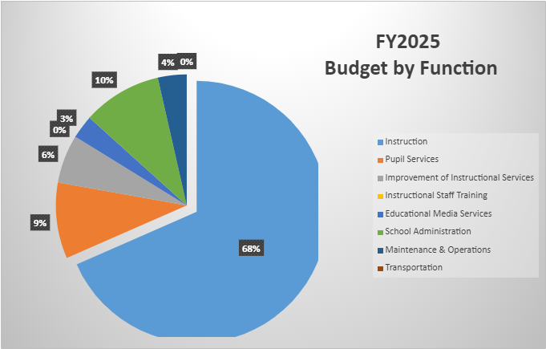
FY25 Budget by Function (Required)
*Based on Current Allocation of School Budget
Notes:
Explain the pie chart and allocations

Slide 15
Discussion of reserve and Holdback funds

Slide 16
Plan for FY25 Leveling Reserve
$54368
Priorities | APS Five Focus Area | Strategies | Requests | Amount
Increase student proficiency In literacy and numeracy | Curriculum and instruction Data Personalized Learning | Provide resources and assist with instruction of students | Provide manipulatives, web- based programs and resources to support student learning | 54368
Notes:
For the next few slides, I will show you how I have allocated the budget to support our strategic priorities.
Based on our strategic priorities and funds we received, here is a break-out of the priorities, which focus area it addresses, the strategies that will be implemented, the purchase request, which funding source was used and the amount.

Slide 17
Plan for FY25 Title I Holdback
$16031
Priorities | APS Five Focus Area | Strategies | Requests | Amount
Increase student performance on Milestones | Curriculum and instruction Data Personalized learning | Extended day program | Hire teachers to remediate students 5 hours weekly for 8 weeks | 11031
Increase parental engagement and student attendance | Whole child | Provide incentives for attendance and participation in school activities | Purchase incentives for students meeting attendance targets | 5000
Notes:
For the next few slides, I will show you how I have allocated the budget to support our strategic priorities.
Based on our strategic priorities and funds we received, here is a break-out of the priorities, which focus area it addresses, the strategies that will be implemented, the purchase request, which funding source was used and the amount.

Slide 18
Questions for the GO Team to Consider and Discuss
Are our school’s priorities (from your strategic plan) reflected in this budget?
Are new positions and/or resources included in the budget to address our major priorities?
Do we know (as a team) the plan to support implementation of these priorities beyond the budget (ex. What strategies will be implemented)?
What tradeoffs are being made in order to support these priorities?
How are district and cluster priorities reflected in our budget?
Cluster priorities- what staff, materials, etc. are dedicated to supporting our cluster’s priorities?
Signature programs- what staff, materials, etc. are dedicated to supporting our signature program?
Are there positions our school will share with another school, e.g. nurse, counselor?
Notes:
CHAIR - Our final task for today! Here are questions that we need to consider to ensure we have a good working draft budget. Let’s walk through them together.

Slide 19

Questions?

Slide 20
The GO Team needs to TAKE ACTION (vote) on the presented budget. After the motion and a second, the GO Team may have additional discussion. Once discussion is concluded, the GO Team will vote.
Action on the Budget

Slide 21

Security Grant
Survey

Slide 22
Annoucements

Slide 23
Provide Your Feedback on the Final APS Student Calendar Survey
Atlanta Public Schools has used widespread community engagement to create two calendar options for the following school years: SY 25-26, SY 26-27, and SY 27-28.
Your feedback through this survey is valuable and will be another important piece of information that the Superintendent and the APS School Board of Education will use to make a final decision about our future school calendars.
HOW: Scan the QR code or click the link for a quick survey.
WHO: All stakeholders, including students, staff, families,
and community members.
WHEN: Open from Mon, February 19th to Fri, March 15th
https://survey.co1.qualtrics.com/jfe/form/SV_0VrymDxIIaygE9E
To learn more about the APS Student Calendar development process, visit https://www.atlantapublicschools.us/Page/71713

Slide 24
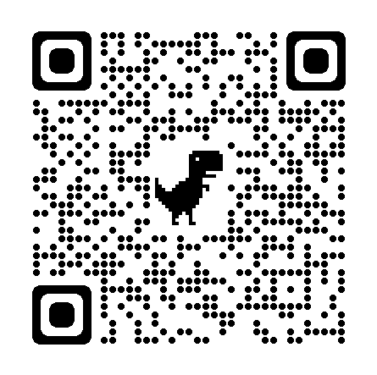
Comparta su opinión en la encuesta final del Calendario Escolar de APS
Basándose en la participación de la comunidad en general, Atlanta Public Schools ha elaborado dos opciones de calendario para los próximos años escolares: 2025-2026, 2026-2027 y 2027-2028.
Su opinión en esta encuesta cuenta y será un factor más que la Superintendente y la Junta de Educación de APS considerarán al momento de tomar la decisión final sobre los calendarios escolares futuros.
CÓMO: Escanee el Código QR o haga clic en el enlace para completar una breve
encuesta.
QUIÉN: Todas las partes interesadas, incluidos alumnos, personal escolar,
familias y miembros de la comunidad.
CUÁNDO: abierta desde el lunes 19 de febrero hasta el viernes
15 de marzo
https://survey.co1.qualtrics.com/jfe/form/SV_cAqsxuT3U5nNu0m?Q_lang=ES
Para más información sobre el proceso de desarrollo del Calendario Escolar para Estudiantes de APS, visite: https://www.atlantapublicschools.us/Page/71713

Slide 25
GO Team members remember to:
  Complete your required trainings
    Orientation
    Ethics
    Budget
  Complete the end of year surveys (check your email for the links)
    GO Team Self-Assessment
    Principal Feedback

Slide 26
Questions?

Slide 27

Thank you

